Slide 1
Movie Buddy
Android Study Jam Final Project Demo
Susana Lau

Slide 2
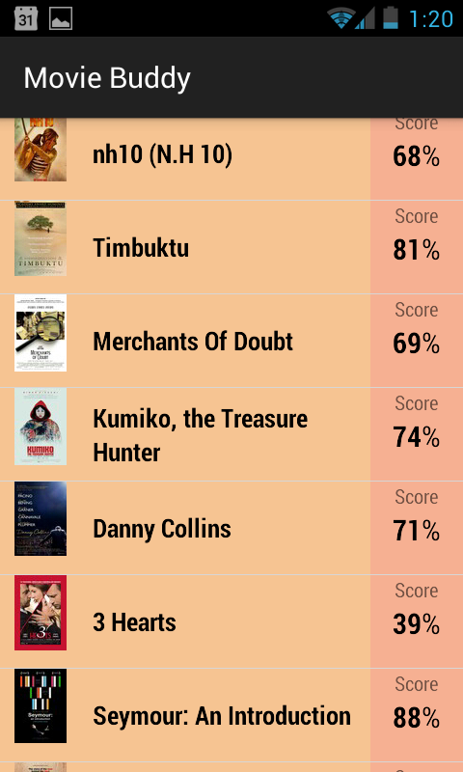
Using Rotten Tomatoes API
Displaying movies playing on theaters and audience score

Slide 3
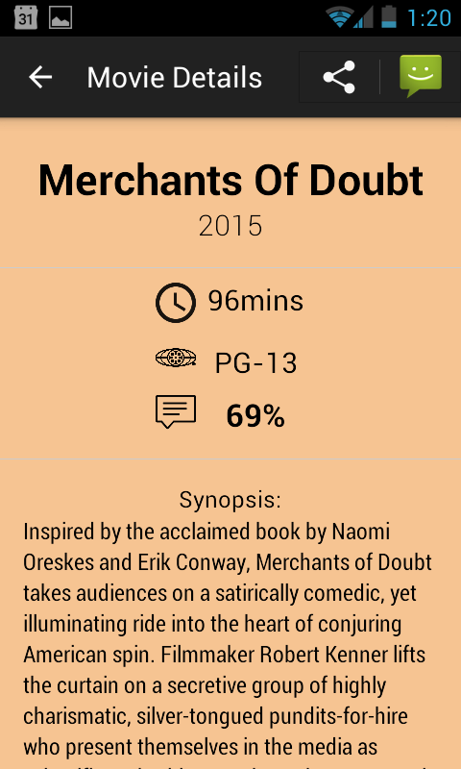
Movie Details
Year of release
Duration
MPAA rating
Synopsis

Slide 4
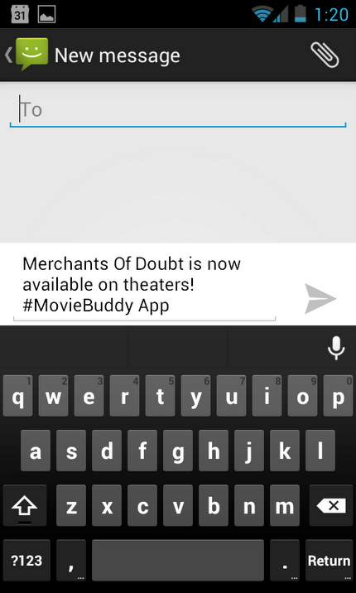
Sharing the new released movie

Slide 5
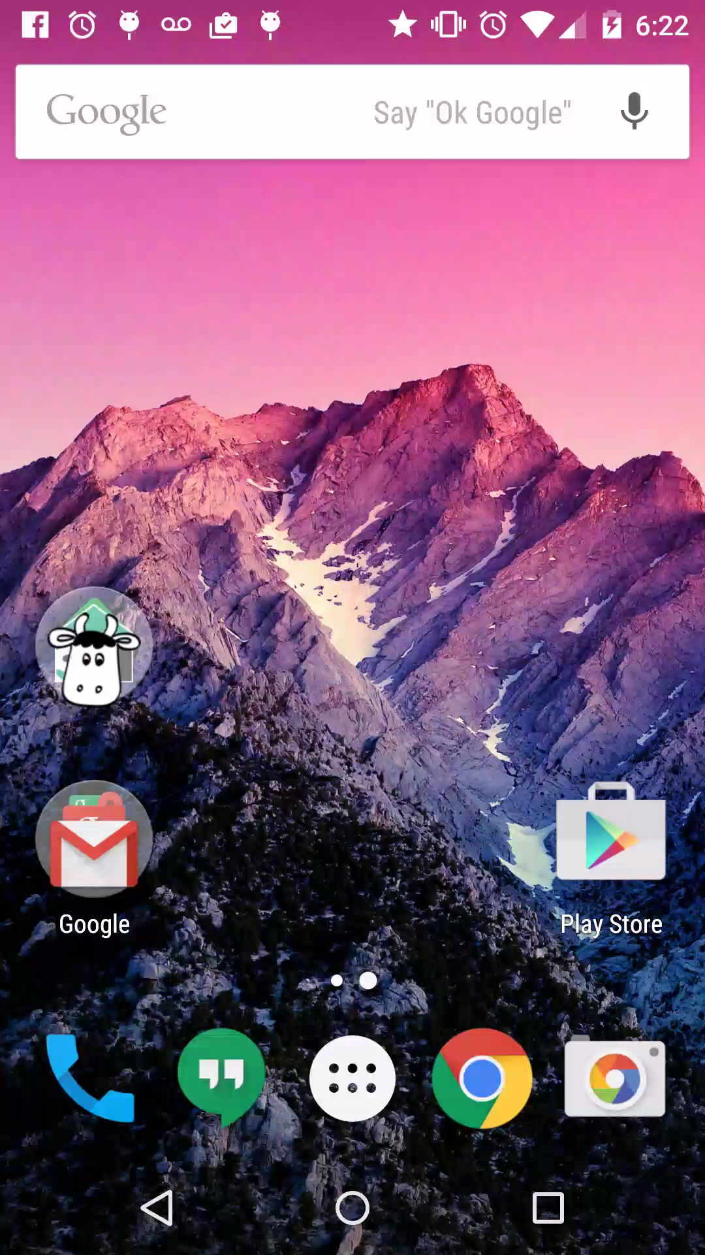
Demo

